Slide 1
Foreclosures, Unemployment and Crime Rate
Lixin Tian
Shubhangi K
Reena Patel
Joseph Kunz
Raj Shah

Slide 2
The Question…
Do foreclosures cause crime and affect unemployment rate in Los Angeles City?
Notes:
Related research has reported subjective evidence suggesting that foreclosed properties attract vandalism, trespassing, prostitutes, drug related crime, squatters and copper thieves.
However research to support those claims has been lacking, and disagreement continues about whether foreclosures and bank-owned properties increase neighborhood crime in Los Angeles City.

Slide 3
Questions raised?
Link between foreclosure and crime by comparing crime in areas with foreclosure properties to crime in areas without foreclosure properties
How does foreclosures affect unemployment rate?
What types of crimes are more sensitive to foreclosures?
Is there a threshold level of foreclosures that triggers crime?
Which property type had highest foreclosures?
Notes:
Crime may increase as local residents are less able to recognize outsiders and to maintain the effective social controls

Slide 4
Data Sources
Crime Data: (https://data.lacity.org/A-Safe-City)
Crimes reported in Los Angeles City between 2016 and 2019.
Dataset includes the spatial coordinates of each reported crime, along with its date, time, and offense categories.
Foreclosure Data: https://catalog.data.gov
Foreclosure reported in Los Angeles City between 2016 and 2019.
Dataset contains each reported foreclosures, along with its reported date, property type, location and lender information.
Unemployment Data: https://www.labormarketinfo.edd.ca.gov/file/lfhist
Los Angeles City Unemployment Rate between 2016 and 2019.
Dataset contains Los Angeles City Unemployment Rate for each year.
Notes:
Crime Data: We have found data on all crimes reported in Los Angeles City between 2016 and 2019. This detailed dataset includes the spatial coordinates of each reported crime, along with its date, time, and offense categories.
Crime Data Source:
Foreclosure Data: We used data on all foreclosure reported in Los Angeles City between 2016 and 2019. This comprehensive dataset contains each reported foreclosures, along with its reported date, property type, location and lender information.
Foreclosure Data Source:

Slide 5
YoY Comparison
Year | Crime Count | Foreclosure Count | Unemployment Rate
2016 | 224625 | 7638 | 5.30%
2017 | 229898 | 5424 | 4.80%
2018 | 226807 | 3055 | 4.70%
Notes:
Crime Data: We have found data on all crimes reported in Los Angeles City between 2016 and 2019. This detailed dataset includes the spatial coordinates of each reported crime, along with its date, time, and offense categories.
Crime Data Source:
Foreclosure Data: We used data on all foreclosure reported in Los Angeles City between 2016 and 2019. This comprehensive dataset contains each reported foreclosures, along with its reported date, property type, location and lender information.
Foreclosure Data Source:

Slide 6
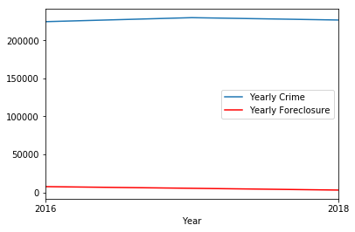
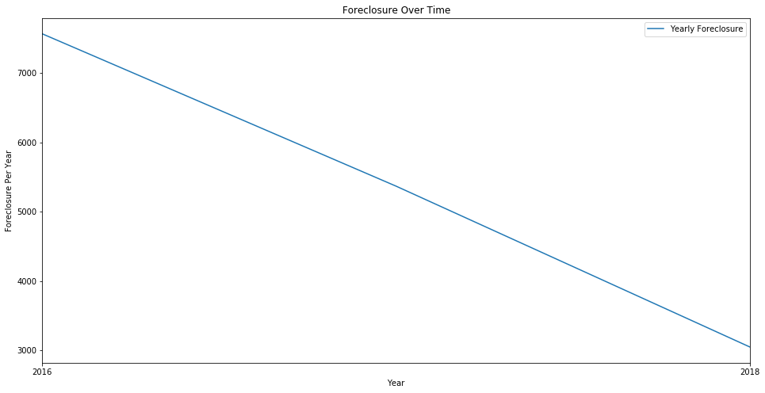
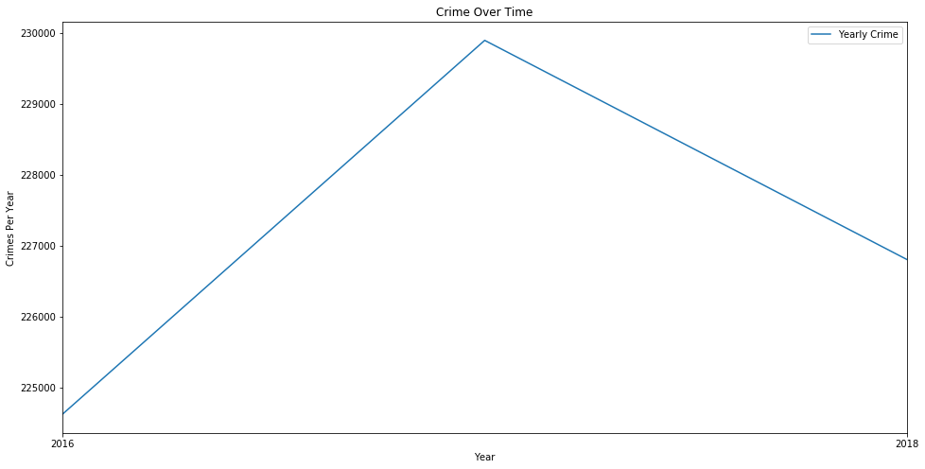
Foreclosures Vs Crime (YOY 2016 – 2018)

Slide 7
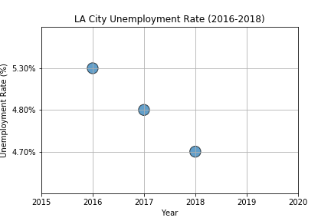
YOY Unemployment Rate (YOY 2016 – 2018)

Slide 8
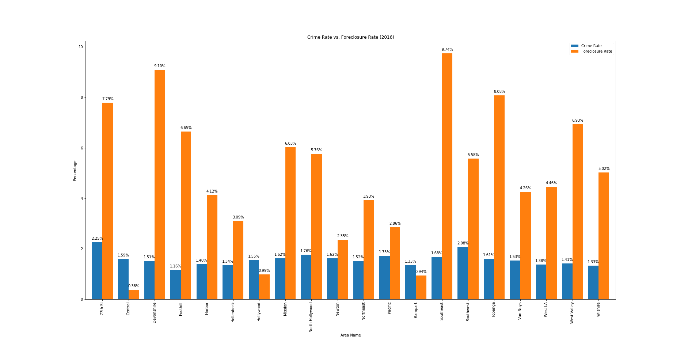
Top Crimes in foreclosure zones (2016)

Slide 9
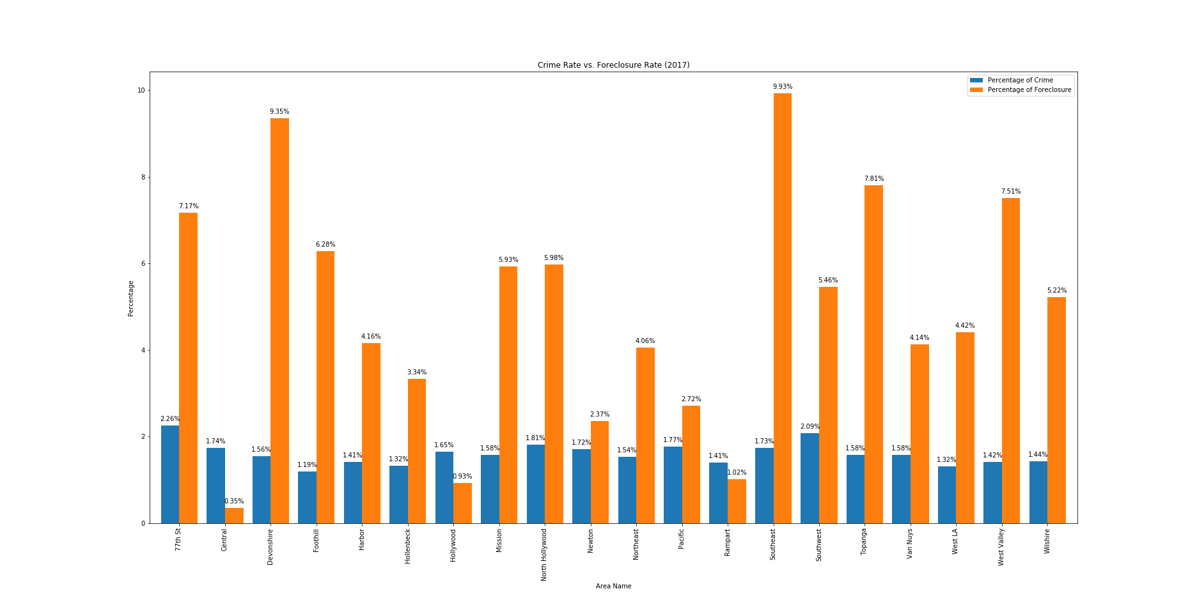
Top Crimes in foreclosure zones (2017)

Slide 10
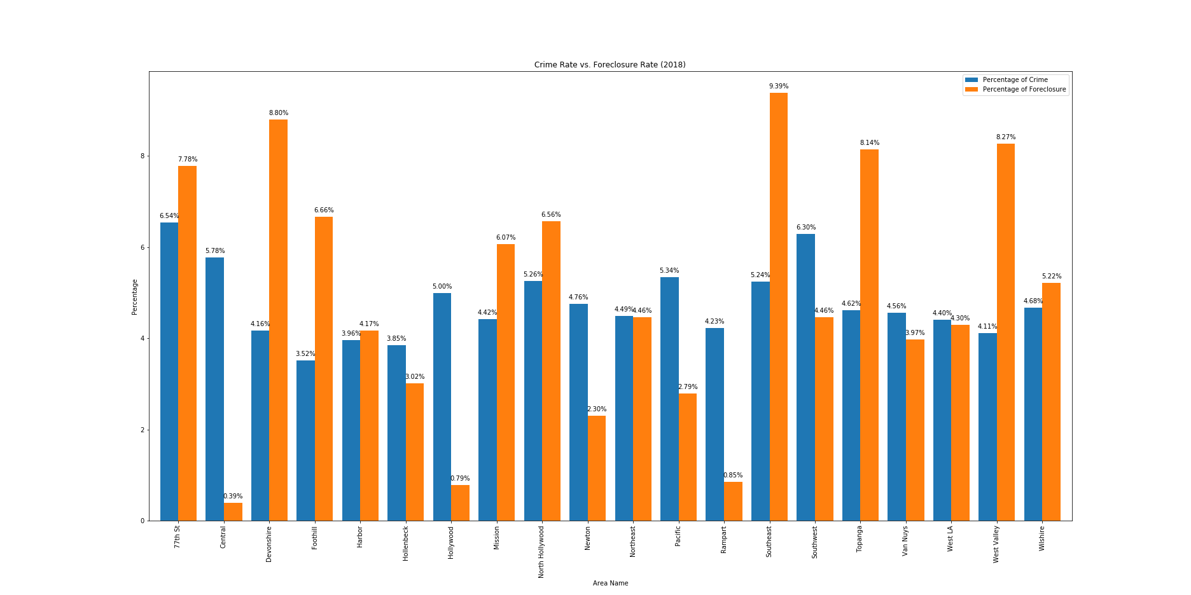
Top Crimes in foreclosure zones (2018)

Slide 11
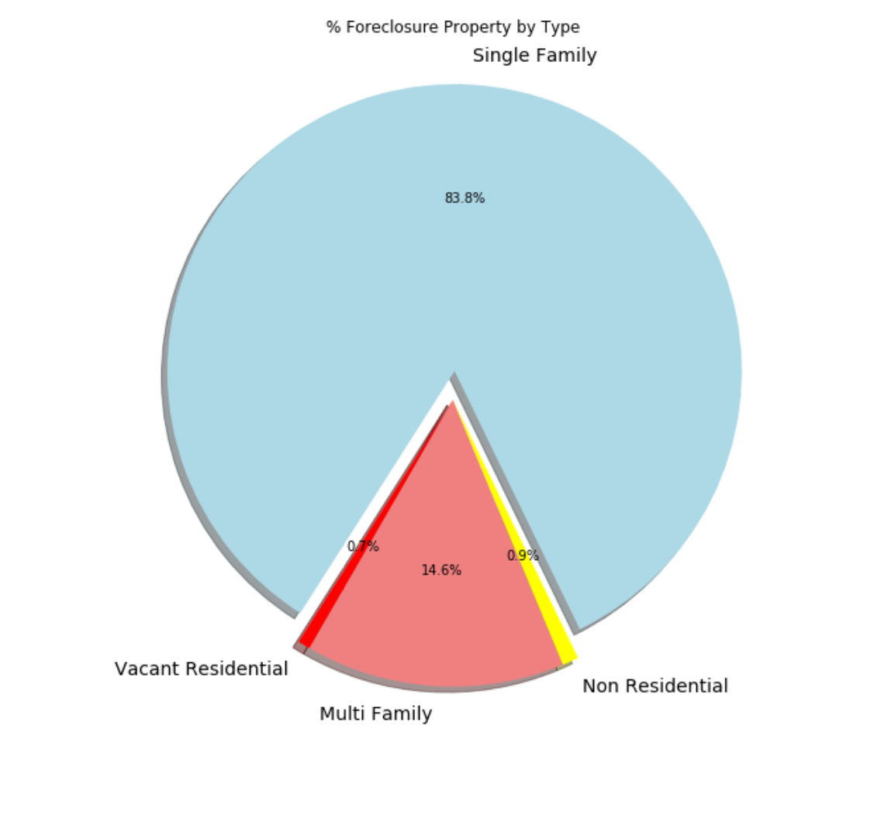
foreclosure by Property Type (2016-2018)

Slide 12
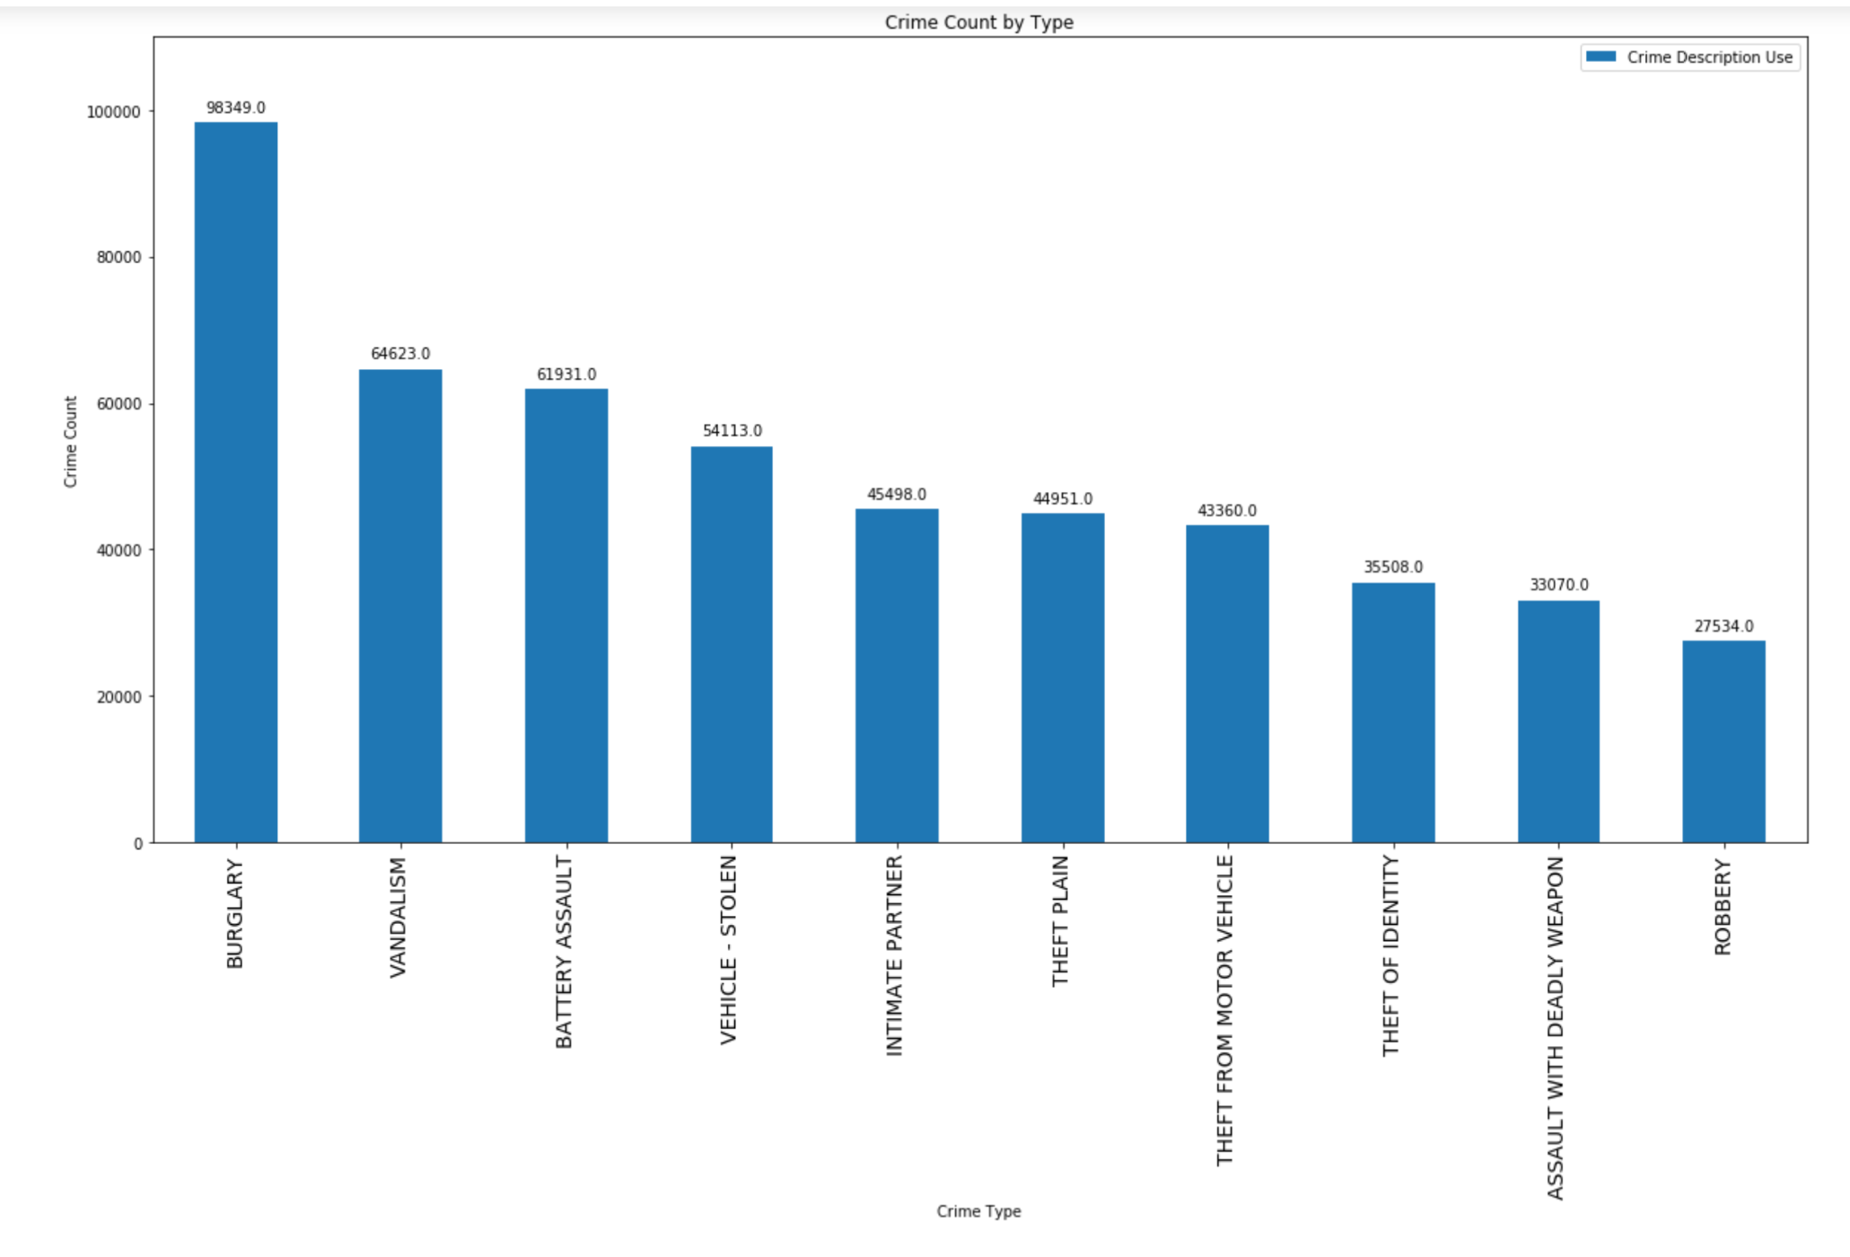
Top 10 Crimes in foreclosure zones (2016-2018)

Slide 13
Data Cleanup and exploration
Cleaning up with pandas:
Create consolidated report of 2016-2019 Crime and Foreclosure
Extract 2016-2019 Unemployment data for Los Angeles city
Add Zip code column using latitude and longitude information in crime data (Used google API)
Merge Crime data and Foreclosure data using Zip code column and removed unnecessary columns.
Notes:
Discuss the steps you took to analyze the data and answer each question you asked in your proposal

Slide 14
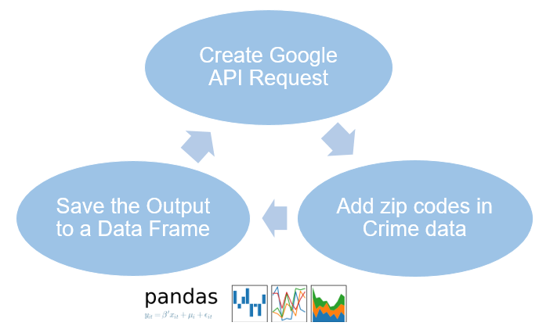
Data Retrieval: Google API to add area zip codes in crime data
Notes:
* Discuss the steps you took to analyze the data and answer each question you asked in your proposal

Slide 15
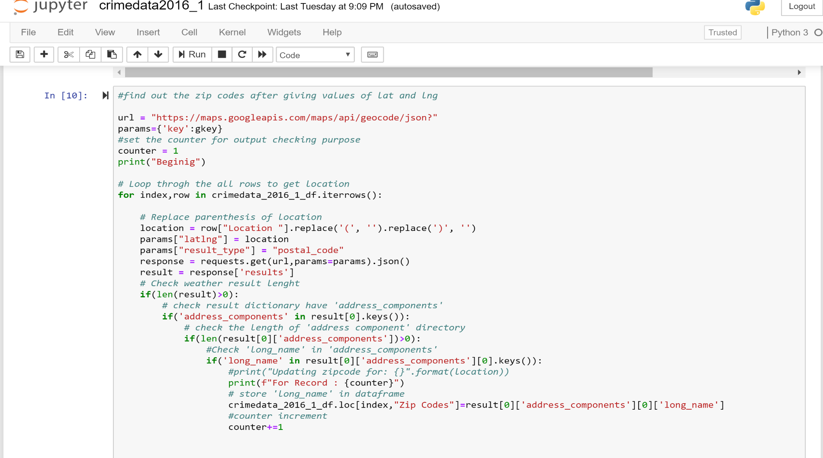
Data Retrieval: Google API to add area zip codes in crime data
Notes:
* Discuss the steps you took to analyze the data and answer each question you asked in your proposal

Slide 16
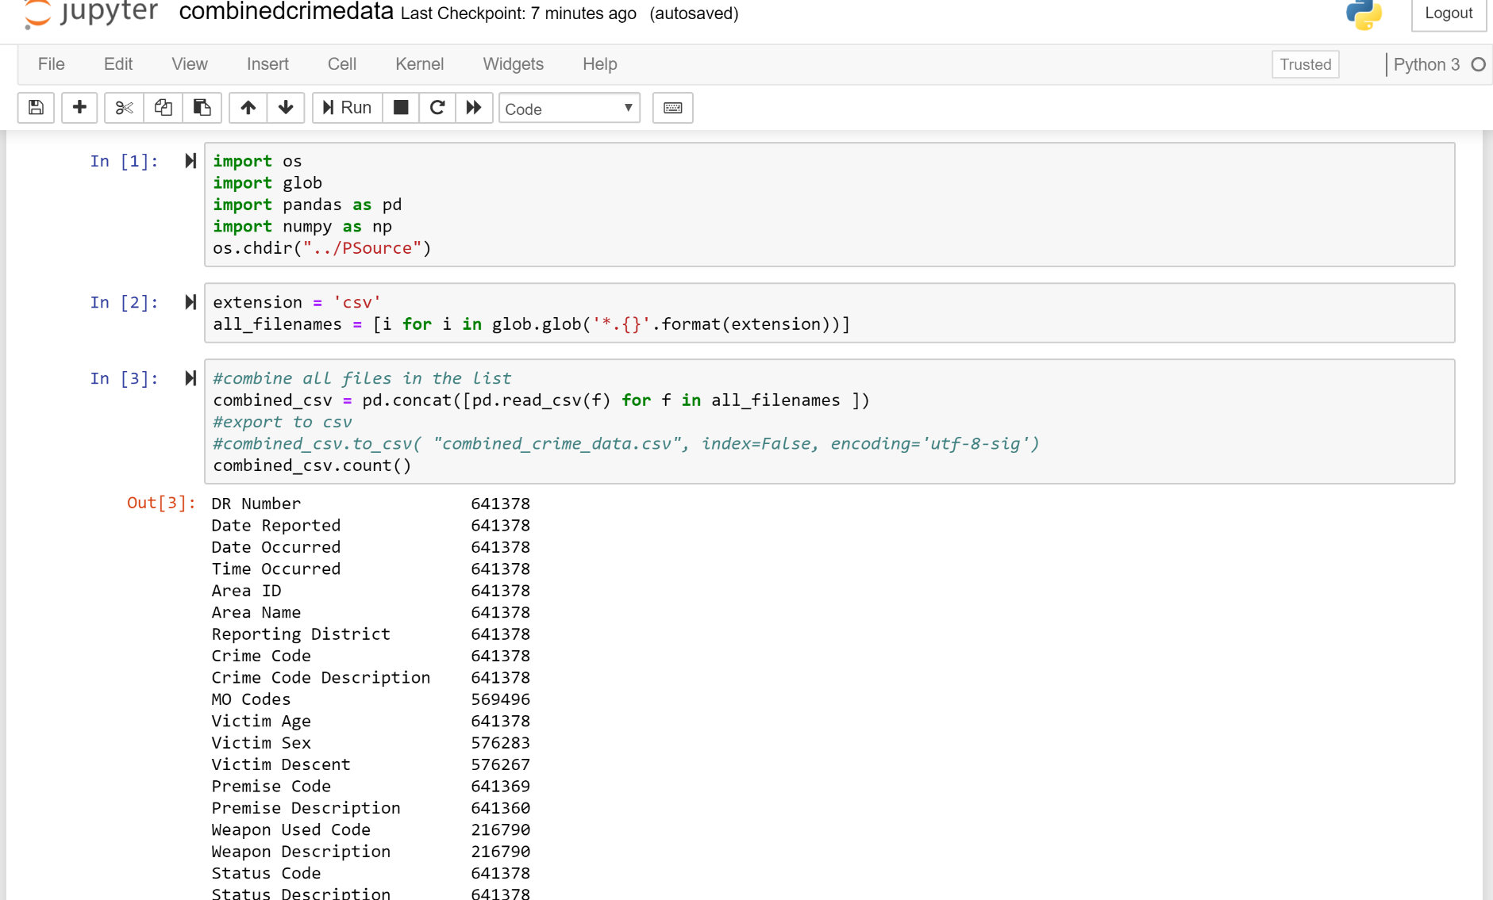
Data Retrieval: Merged Crime and Foreclosure Data
Notes:
* Discuss the steps you took to analyze the data and answer each question you asked in your proposal

Slide 17
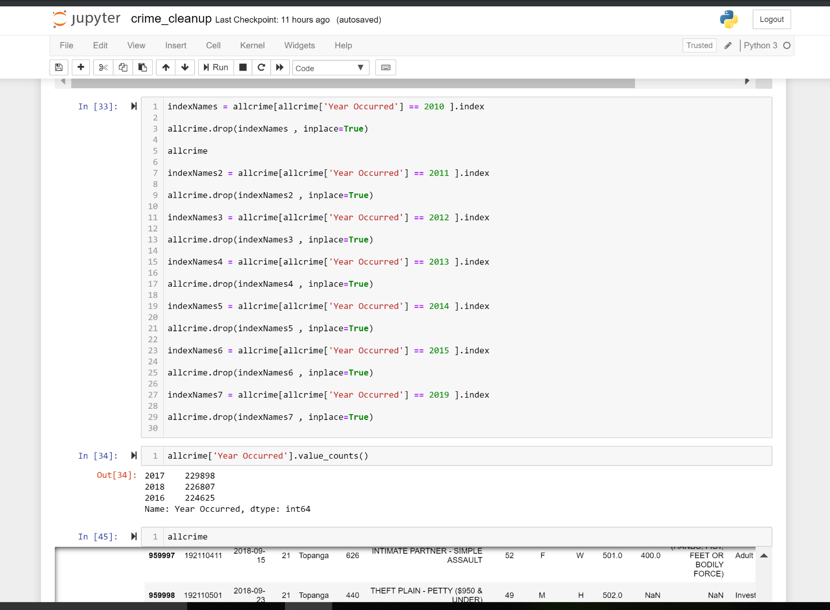
Data frames for grouped bar graph
Notes:
* Discuss the steps you took to analyze the data and answer each question you asked in your proposal

Slide 18
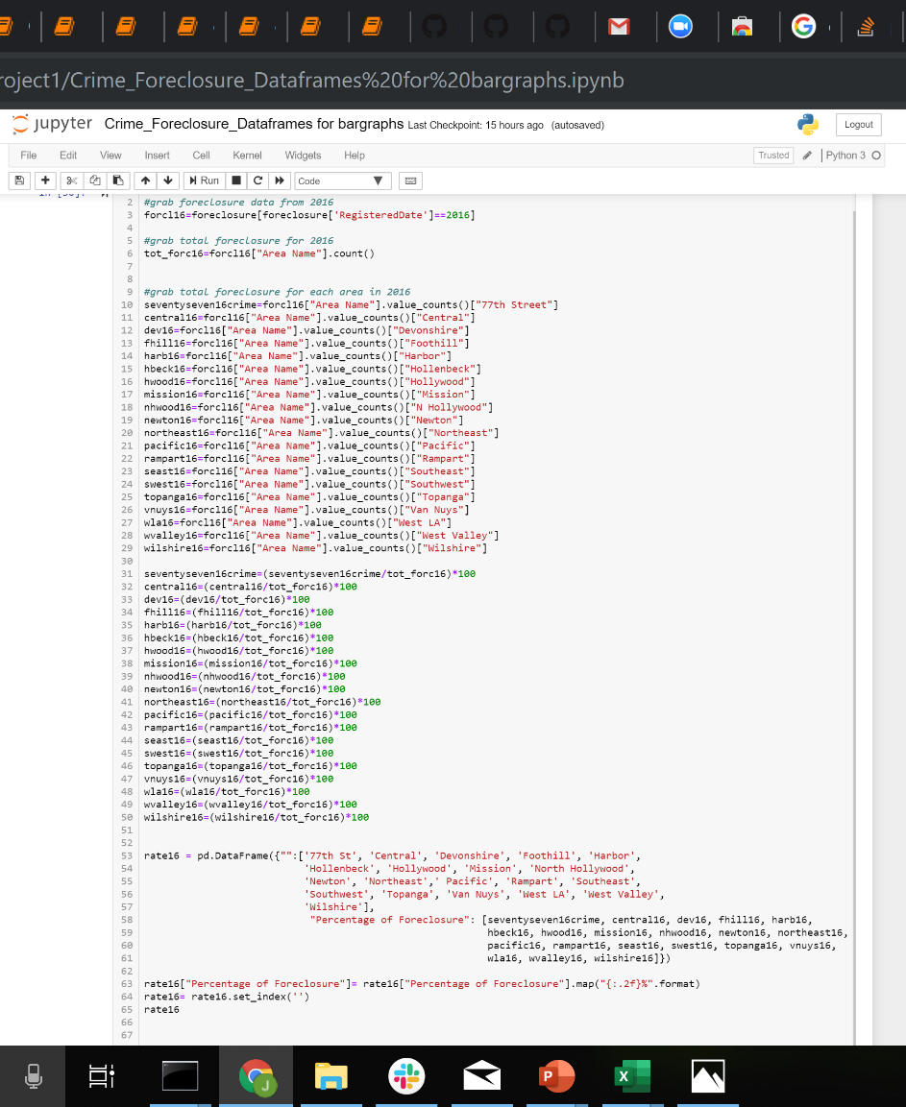
Data frames for grouped bar graph
Notes:
* Discuss the steps you took to analyze the data and answer each question you asked in your proposal

Slide 19
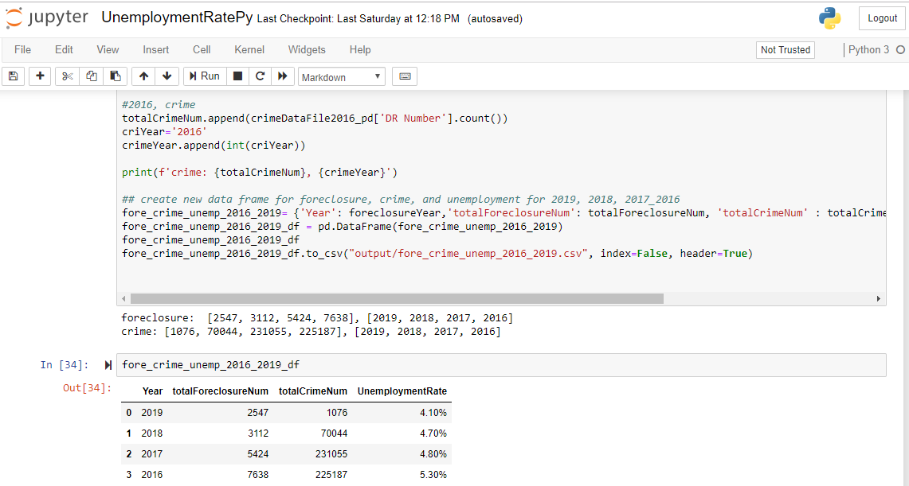
Analyze for Trends (Table)
Notes:
* Discuss the steps you took to analyze the data and answer each question you asked in your proposal

Slide 20
Conclusion
Based on our analysis, we do observe a small but significant positive “net” effect of foreclosure and unemployment rates in 2016 on crime. In particular, by analyzing each year separately, we show that neighborhood foreclosure is not significantly associated with crime in a small number of selected areas; in the majority of the areas considered, foreclosure did not exert a significant main effect on either crime type.
Year | Crime Count | Foreclosure Count | Unemployment Rate
2016 | 224625 | 7638 | 5.30%
2017 | 229898 | 5424 | 4.80%
2018 | 226807 | 3055 | 4.70%
Notes:
* Discuss the steps you took to analyze the data and answer each question you asked in your proposal

Slide 21
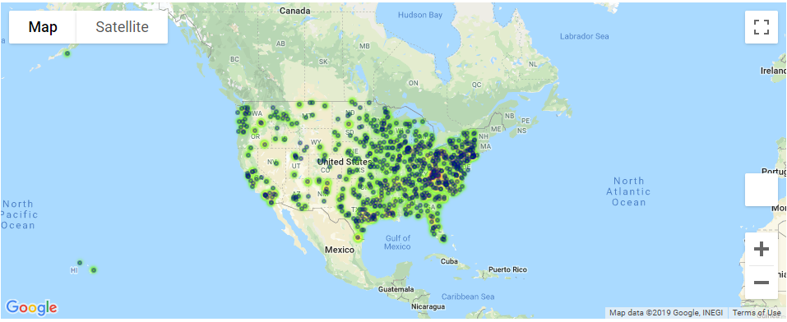
if we had two more weeks, we would have researched….
Notes:
Discuss any difficulties that arose, and how you dealt with them
* Discuss any additional questions that came up, but which you didn't have time to answer: What would you research next, if you had two more weeks?

Slide 22
Limitations in Analysis
We just had access to foreclosure filings or notices data, however if we were able to track foreclosure filings from initiation to resolution that would allows us to better understand how foreclosures resulting in different outcomes affect crime.
We could have find out if impacts on crime vary depending on the outcomes of the foreclosures.
Notes:
Discuss insights you had while exploring the data that you didn't anticipate

Slide 23
Questions…
Q&A

